Slide 1

Flutter

Slide 2
Flutter
Flutter is an open-source UI software development toolkit created by Google. It is used to build natively compiled applications for mobile (Android, iOS), web, and desktop from a single codebase.
Key Features of Flutter:
Single Codebase: Write one set of code and run it on multiple platforms.
Dart Language: Uses Dart, a modern and fast programming language developed by Google.
Widgets: Everything in Flutter is a widget. It provides a rich set of customizable widgets for creating complex UIs.
Hot Reload: Instantly see the results of changes without restarting the app.
High Performance: Compiles to native ARM code for mobile, making it fast and smooth.
Custom UI: Easily create beautiful UIs with custom themes and animations.
You can build Mobile Apps (Android & iOS), Web apps, Desktop (Windows, macOS, Linux) and embedded devices (with some configurations)

Slide 3
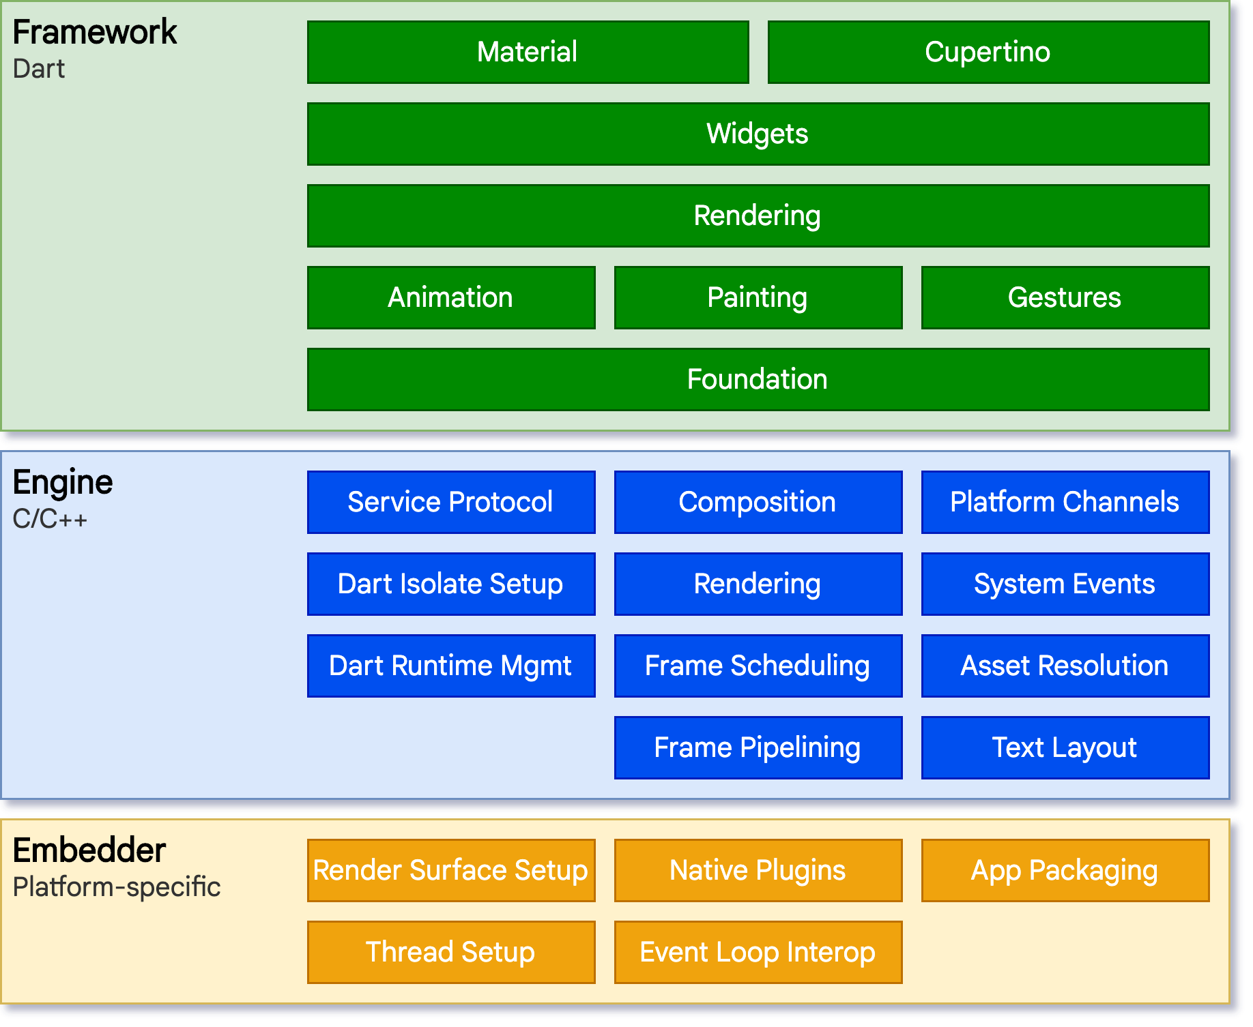
Flutter Architecture
This is the developer-facing layer, written in Dart, where most of your application code lives.
The Flutter Engine is written in C++. It is responsible for rendering, executing Dart code, and handling system-level event
This is the lowest layer that integrates Flutter with the host platform (Android, iOS, Windows, macOS, Linux). Each platform has its own embedder written in native code (Java/Kotlin for Android, Objective-C/Swift for iOS, etc.).

Slide 4


Flutter Versions
2018
Flutter 1.0 Apps for Android and iOS
2022
Flutter 2.10 Stable for desktop
2018
Flutter 1.0 stable version for Android, iOS and web beta version
2022
Flutter 3.0 Stable support for all platforms
2019
Flutter 1.0 stable version for Android, iOS and web beta version
Flutter 2.0 web stable and beta version for desktop
Flutter 3.2.9 on going
2020
2023

Slide 5






Dart Basics
var
int
Inferred from data assigned.
06
01
Stores integer values
dynamic
double
Data type is inferred from data assigned
05
Data Types
02
Stores decimal values
bool
num
Used for storing Boolean values
04
03
Stores integer and decimal

Slide 6
Collections
List
List
List is used to store data in a sequence. It is a generic class.
List<int> numbers=[4, 5 ];
01
Set
Set
Dart Collections
02
Set is used to store data collection. Set stores unique values.
Set<int> numbers={25,30 };
Map
Map
03
Map is used to store key base values.
Map<String,int> data={“123”, 20000};

Slide 7
Arithmetic Operators
Operator | Description | Example
+ | Addition | a + b
- | Subtraction | a - b
* | Multiplication | a * b
/ | Division (double) | a / b
~/ | Integer Division | a ~/ b
% | Modulus (remainder) | a % b

Slide 8
Arithmetic Assignments Operators
Operator | Description | Example
= | Assign value | a = b
+= | Add and assign | a += b
-= | Subtract and assign | a -= b
*= | Multiply and assign | a *= b
/= | Divide and assign | a /= b
~/= | Integer divide and assign | a ~/= b
%= | Modulus and assign | a %= b

Slide 9
Comparison Operators
Operator | Description | Example
== | Equal to | a == b
!= | Not equal to | a != b
> | Greater than | a > b
< | Less than | a < b
>= | Greater than or equal to | a >= b
<= | Less than or equal to | a <= b

Slide 10
Logical Operators
Operator | Name | Example
&& | Logical AND | true && false
|| | Logical OR | Logical OR
! | Logical NOT | !true

Slide 11
Null-aware Operators
Operator | Description | Example
?? | Returns value if not null | a ?? b
??= | Assigns only if null | x ??= 10
?. | Calls member only if not null | user?.name

Slide 12
Non-nullable vs Nullable Integer
int a = 10; // ✅ Non-nullable int
int? b = null; // ✅ Nullable int (can hold null)
int x = null; // ❌ Compile-time error
int num1,num2;
num1=5;
num2=2;
double answer= num1/num2; // asnwer of / operator is always double
String output=num1.toString()+"/"+num2.toString()+"="+answer.toString();
print(output);
output="${num1}/${num2}=${answer}";
String paragrpah='''
This is a multi line text
''';

Slide 13
Nullable Types
Allows variable to hold null
Example:
String? name;
int? age;

Slide 14
Null-aware Access ?.
Access property only if value is not null
Example:
print(name?.length);

Slide 15
Null-coalescing Operator ??
Provides default value if null
Example:
print(city ?? "Islamabad");

Slide 16
Null-aware assignment ??=
Assign value only if variable is null
Example:
country ??= "Pakistan";

Slide 17
Null Assertion Operator !
Tells Dart value is NOT null
• Use carefully
Example:
print(name!);

Slide 18
Dynamic
dynamic d1,d2;
d1=100;
d2=250;
dynamic d3=d1+d2;
d1="Dart";
d2="Flutter";
d3=d1+d2;
d1="Dart";
d2=100;
d3=d1+d2; // exception

Slide 19
If else
int marks = 45;
if (marks >= 40) {
print("Pass");
} else {
print("Fail");
}
int score = 72;
if (score >= 80) {
print("Grade A");
}
else if (score >= 60) {
print("Grade B");
} else if (score >= 40) {
print("Grade C");
} else {
print("Fail");
}

Slide 20
Methods
void printData(String data)
{
print(data);
}
// Function calling
printData("Flutter is Google UI framework");

Slide 21
Methods
int computeSum(int a,int b)
{
return a+b;
}
OR if the function body has single statement
int computeSum(int a,int b) => a+b;
int answer=computeSum(5, 6); // Function Call

Slide 22
Named Parameters
int getMax( )
{
return a>b?a:b;
}
{required int a,required int b}
int max=getMax(a: 12, b: 21);
int max=getMax(b: 21, a: 12);

Slide 23
Optional Parameters
int getMax({required int a,int b=0}) // Parameter has some default value
{
return a>b?a:b;
}
int max=getMax(a: 12);
int max=getMax(a: 12, b: 24); // will update the default value of b

Slide 24
OverLoading
void textFormatter({required String text,int fontSize=12,bool isBold=false})
{
//...
}
textFormatter(text:'My text');
textFormatter(text:'My text',fontSize: 20);
textFormatter(text:'My text',isBold: true);
textFormatter(text:'My text',isBold: true,fontSize: 15);
You can not write another function with name textFormatter in a class or in a dart file.

Slide 25
Sequence and Named Parameter
void textFormatter(String text,{int fontSize=12,bool isBold=false})
{
//...
}
textFormatter('My text');
textFormatter('My text',fontSize: 20);
textFormatter('My text',isBold: true);
textFormatter('My text',isBold: true,fontSize: 15);

Slide 26
Optional Parameters
List<Product> filterProducts(
{
required List<Product> products, String? category, double? minPrice, double? maxPrice,
bool onlyAvailable = false }
){
// code here
}

Slide 27
Function Returning Multiple Values
(double,double) getCurrentLocation()
{
return (37.4219983,-122.084);
}
double lat,long;
(lat,long)=getCurrentLocation();

Slide 28
Function with no return type
printData()
{
print("Data printer");
}
calSum(int x,int y)
{
return x+y;
}
Function whose return type is missing its return type is considered dynamic

Slide 29
Function with missing parameter type
pluOperator(x,y)
{
return x+y;
}
x and y has dynamic as data type
pluOperator(5,10);
Will compute sum of 5 and 10
pluOperator("Dart", "Flutter");
Will concatenate both
pluOperator("Dart",10);
Exception

Slide 30
List

